Slide 1
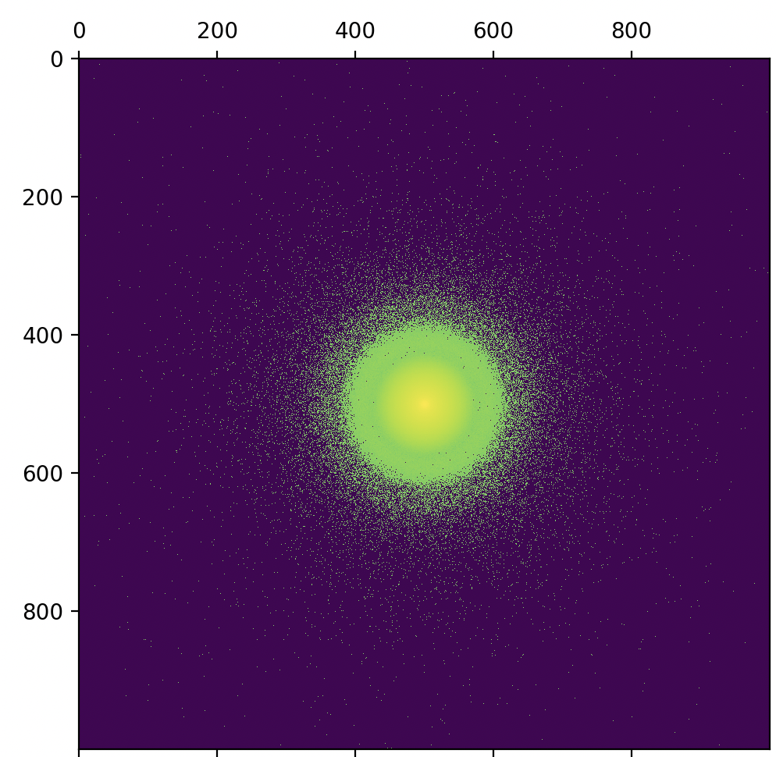
Simulation Tutorial

Slide 2
Contents
Simulation process
Main code
Usage

Slide 3
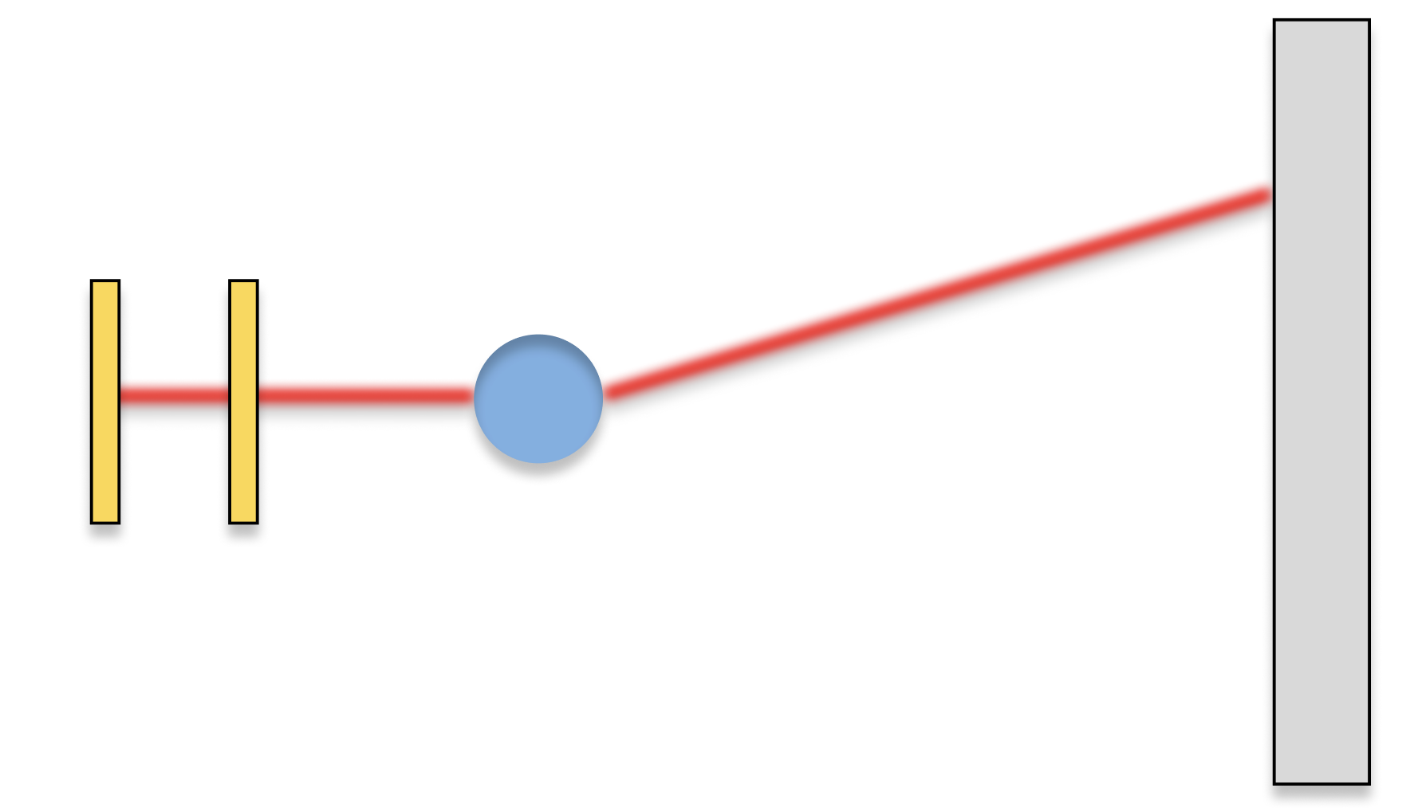
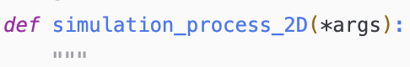
Simulation Process
The code simulates X-ray scattering by means of a Monte-Carlo simulation.
In its core, the simulation process is comprised of the following steps:
Generate a random entry angle, as given by a combination of the slit positions through which the X-ray initially travels. The random generation can be impacted by a beam-profile.
Generate a random exit angle, as given by the form factor of the scattering sample.
Calculate the incident position of the X-ray on the detector.
The following slides will illustrate how each step is implemented.
Step 3
Step 1
Step 2
Detector
Sample
Slits

Slide 4
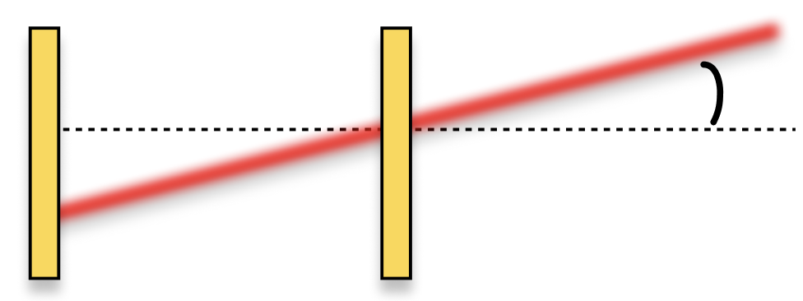
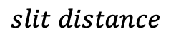
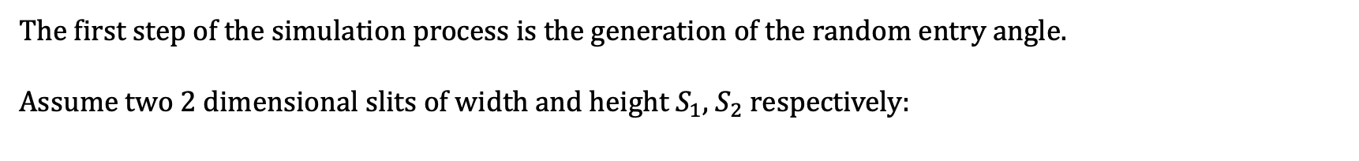
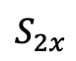
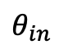
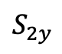
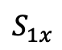
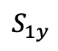

Simulation Process – Entry angle generation
The first step of the simulation process is the generation of the random entry angle.
Assume two 2 dimensional slits of width and height $S_{1}$, $S_{2}$ respectively:
$$slit distance$$
Slit 1
Slit 2
$$θ_{in}$$
$$S_{1y}$$
$$S_{2y}$$
$$S_{1x}$$
$$S_{2x}$$
A given X-ray can travel between any 2 points $[s_{1x},s_{1y}]$, $\left[s_{2x},s_{2y}\right]$, from which the entry angles $θ_{in}, χ_{in}$ can be calculated:
$$θ_{in}=\operatorname{atan}\left(\frac{\sqrt{{\left(s_{2y}−s_{1y}\right)}^{2}+{\left(s_{2x}−s_{1x}\right)}^{2}}}{slit distance}\right), χ_{in}=\operatorname{atan}\left(\frac{s_{2y}−s_{1y}}{s_{2x}−s_{1x}}\right)$$

Slide 5
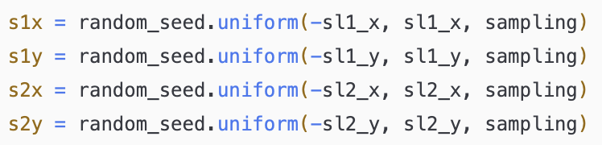
Simulation Process – Entry angle generation code
This step is done in the code by a separate function “sample_from_slits”, which accepts the following inputs:
“random_seed” : The randomization seed to be used for the randomization process
“sl1_x”, “sl1_y”, “sl2_x”, “sl2_y” : The half lengths of slit 1 x, y axes and slit 2 x, y axes, respectively (in centimeters).
“slit_distance” : The distance between the two slits (in centimeters)
“sampling” : The number of X-ray incidents to be generated at once.
From these inputs, the function starts by generating uniformly the random slit positions. Here the ”uniform” method of NumPy is used to ensure the spaces between the slits are simulated as continuous.
From here, the angles are calculated as shown in the previous slide:
Note that “np.mod” is used to normalize the $χ_{in}$ angles to be in the range of $[0, 2π]$, which will be important in further calculations.
TO DO: add a beam profile to the randomization

Slide 6
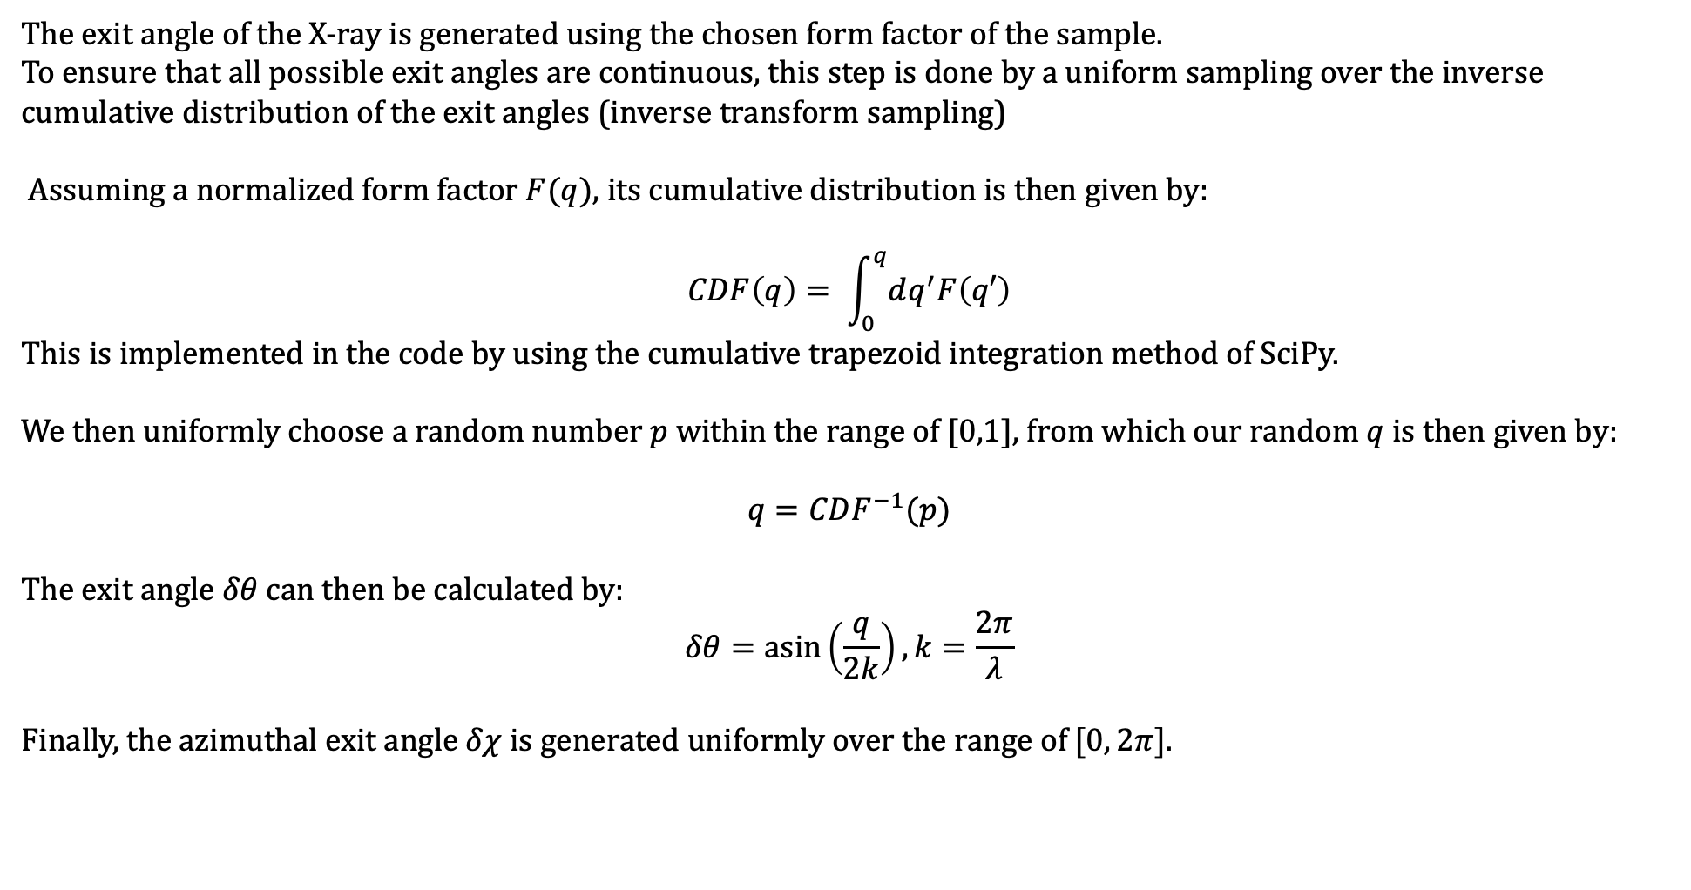
Simulation Process – Exit angle generation
The exit angle of the X-ray is generated using the chosen form factor of the sample. To ensure that all possible exit angles are continuous, this step is done by a uniform sampling over the inverse cumulative distribution of the exit angles (inverse transform sampling)
Assuming a normalized form factor $F(q)$, its cumulative distribution is then given by:
$$CDF\left(q\right)= \int_{0}^{q}{dq^{′}F\left(q′\right)}$$
This is implemented in the code by using the cumulative trapezoid integration method of SciPy.
We then uniformly choose a random number $p$ within the range of [0,1], from which our random $q$ is then given by:
$$q=CDF^{−1}(p)$$
The exit angle $δθ$ can then be calculated by:
$$δθ=\operatorname{asin}\left(\frac{q}{2k}\right), k=\frac{2π}{λ}$$
Finally, the azimuthal exit angle $δχ$ is generated uniformly over the range of $[0, 2π]$.
add drawing for exit angle

Slide 7
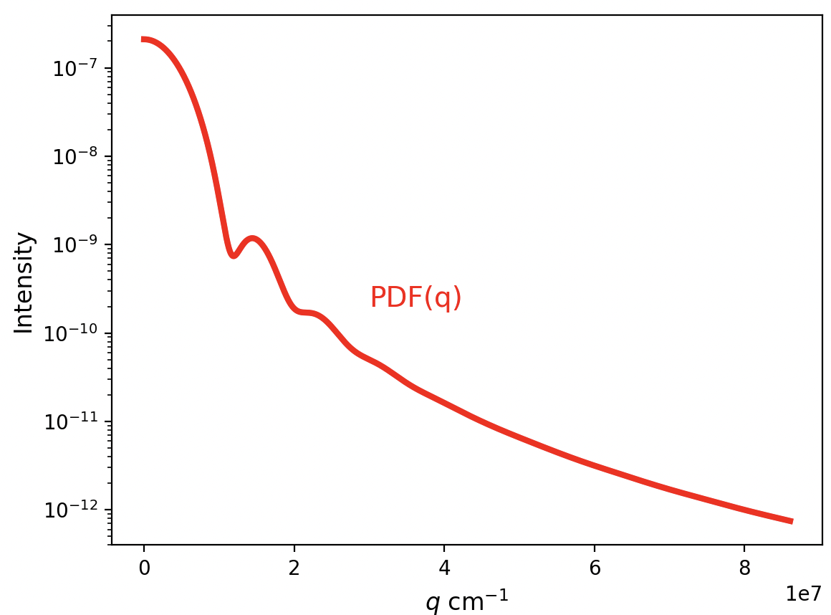
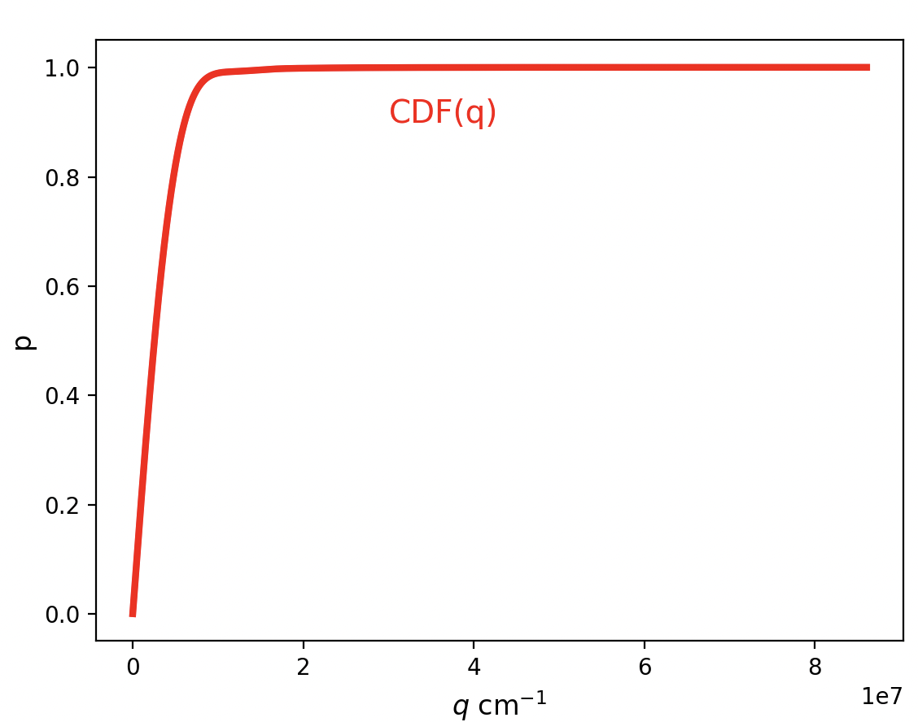
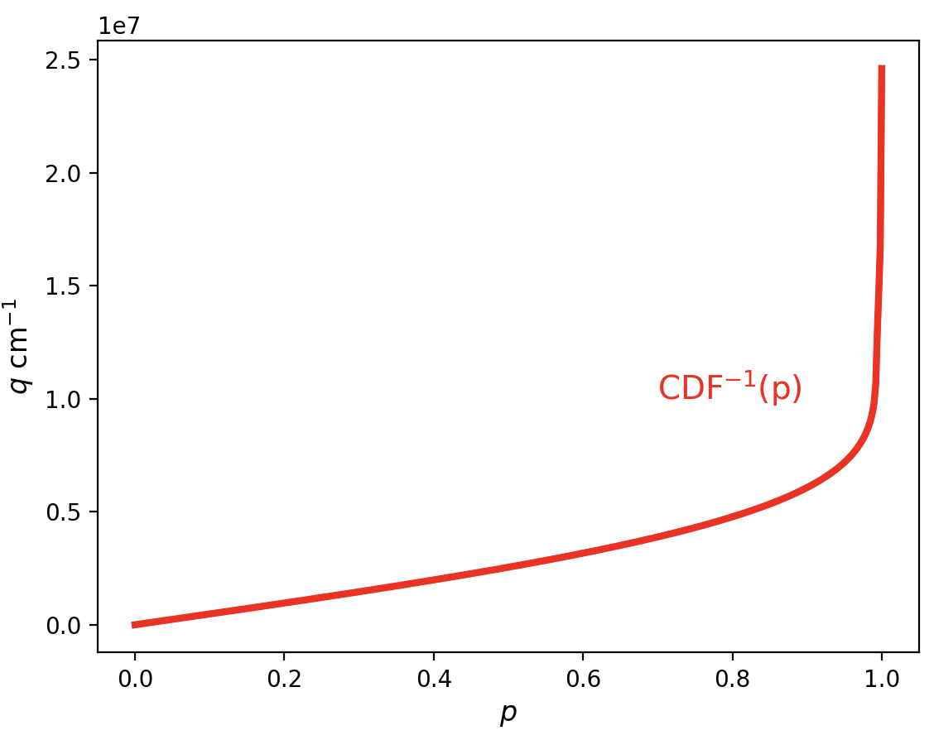
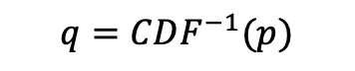
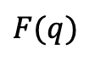
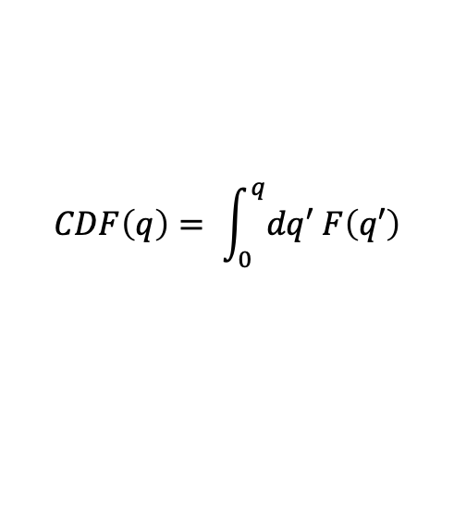
Simulation Process – Exit angle generation
Example: Spherical form factor
$$CDF\left(q\right)= \int_{0}^{q}{dq′ F\left(q′\right)}$$
$F(q)$
$$q=CDF^{−1}(p)$$

Slide 8
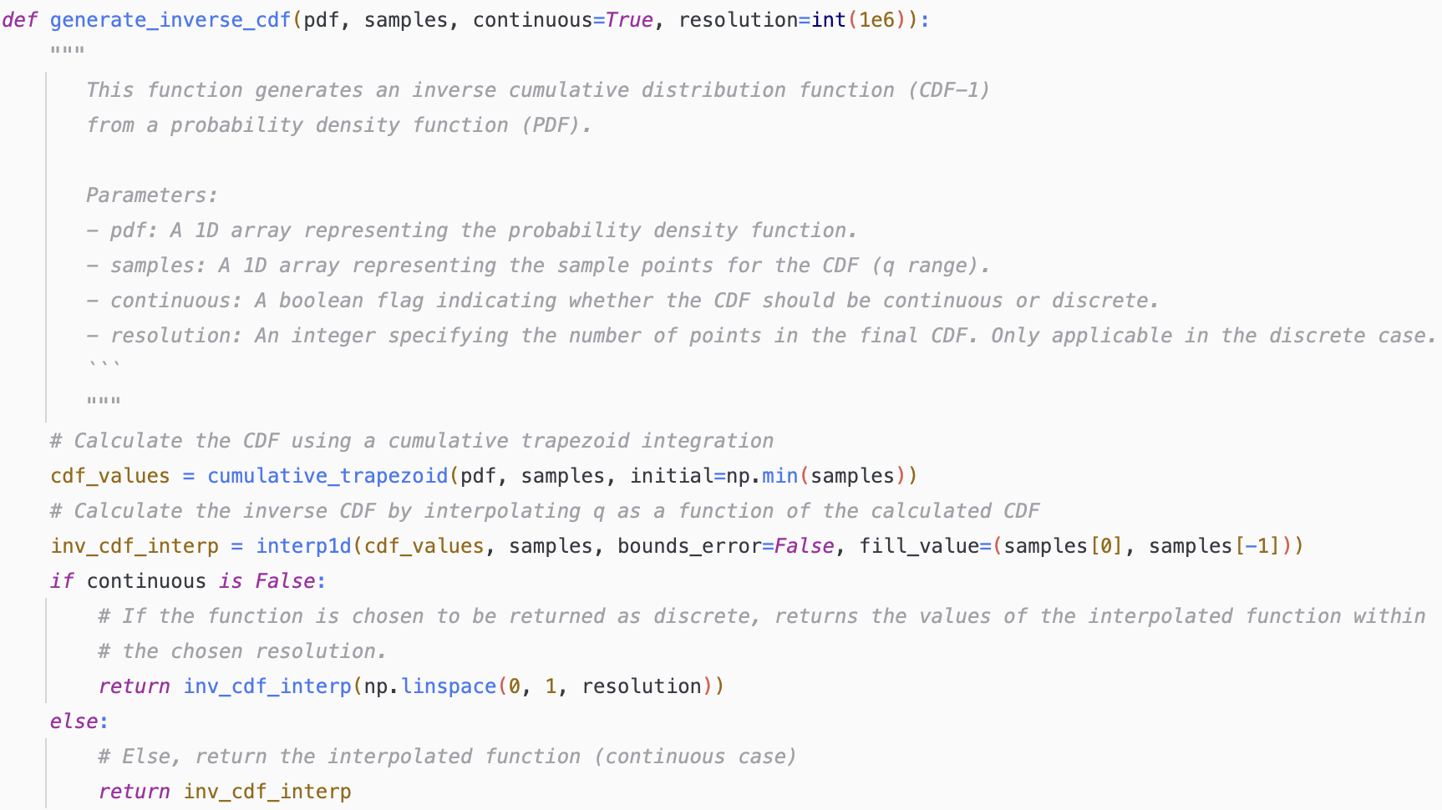
Simulation Process – Exit angle generation code
The inverse CDF is generated within the following function:

Slide 9
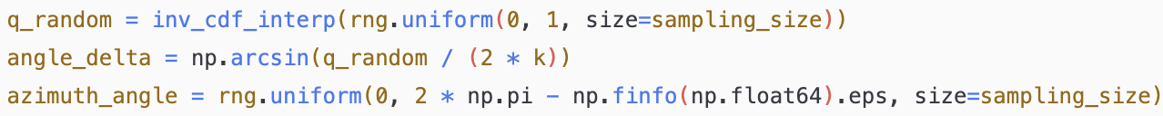
Simulation Process – Exit angle generation code
The final calculation of the exit angles is done within the main simulation process function, which will be discussed more in-depth in later slides.
Here, q_random ($δq$) is chosen uniformly through the interpolated inverse CDF (inverse_cdf_interp) at size sampling_size to reflect sampling_size incidents generated at once.

Slide 10
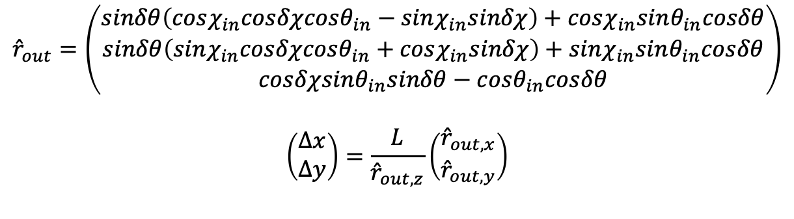
Simulation Process – Final incident position on the detector
The final incident position on the detector of the X-ray is calculated using the expression below, the derivation of which is further expanded in an auxiliary document.
$${\hat{r}}_{out}=\left(\begin{matrix}sinδθ\left(cosχ_{in}cosδχcosθ_{in}−sinχ_{in}sinδχ\right)+cosχ_{in}sinθ_{in}cosδθ \\ sinδθ\left(sinχ_{in}cosδχcosθ_{in}+cosχ_{in}sinδχ\right)+sinχ_{in}sinθ_{in}cosδθ \\ cosδχsinθ_{in}sinδθ−cosθ_{in}cosδθ\end{matrix}\right)$$
$$\left(\begin{matrix}Δx \\ Δy\end{matrix}\right)=\frac{L}{{\hat{r}}_{out,z}}\left(\begin{matrix}{\hat{r}}_{out,x} \\ {\hat{r}}_{out,y}\end{matrix}\right)$$
Here, $L$ is the distance between the second slit and the detector in centimeters, and the angles are the ones as described in the previous slides.
This equation then returns the detector position $[Δx, Δy]$ of the scattering incident.

Slide 11
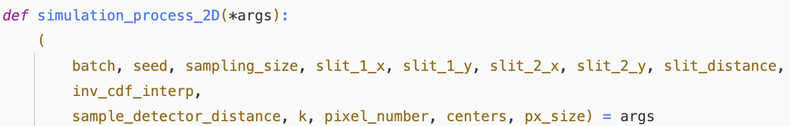
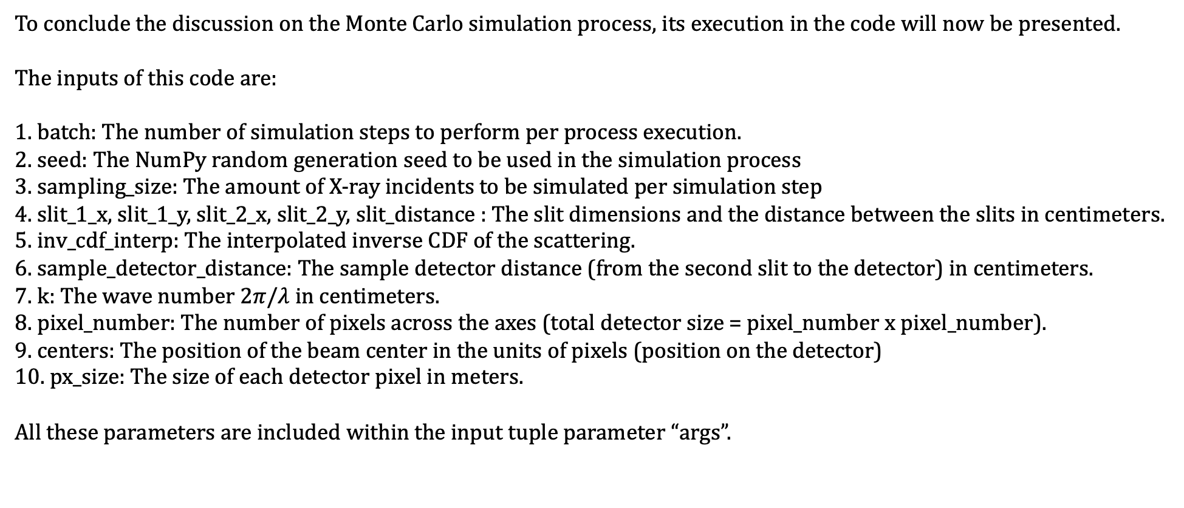
Simulation Process – Main process code
To conclude the discussion on the Monte Carlo simulation process, its execution in the code will now be presented.
The inputs of this code are:
1. batch: The number of simulation steps to perform per process execution.
2. seed: The NumPy random generation seed to be used in the simulation process
3. sampling_size: The amount of X-ray incidents to be simulated per simulation step
4. slit_1_x, slit_1_y, slit_2_x, slit_2_y, slit_distance : The slit dimensions and the distance between the slits in centimeters.
5. inv_cdf_interp: The interpolated inverse CDF of the scattering.
6. sample_detector_distance: The sample detector distance (from the second slit to the detector) in centimeters.
7. k: The wave number $2π/λ$ in centimeters.
8. pixel_number: The number of pixels across the axes (total detector size = pixel_number x pixel_number).
9. centers: The position of the beam center in the units of pixels (position on the detector)
10. px_size: The size of each detector pixel in meters.
All these parameters are included within the input tuple parameter “args”.

Slide 12
Simulation Process – Main process code
The first step of the simulation process is to generate a unique randomization seed to be used in all randomizations further on.
We then define our intensity profile 2D array which will record all the scattering events which will be simulated
Finally, we start our main for loop of the simulation, going over the specified number of batches. The code In the next slide illustrates al the steps which were explained in the previous slides as to how the entry and exit scattering angles are calculated.
Note that the used “prange” argument is a modified version of the usual Python “range” which is more efficient in parallelization. More on the parallelization process will be explained in further slides.

Slide 13
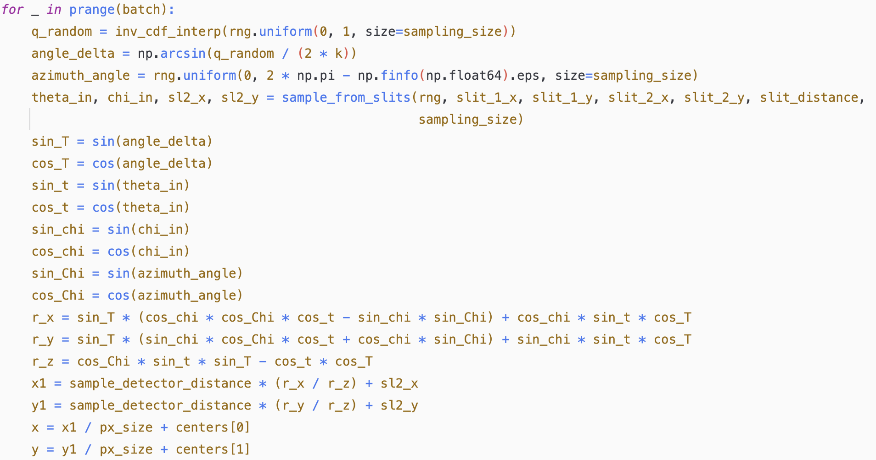
Simulation Process – Main process code

Slide 14
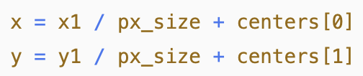
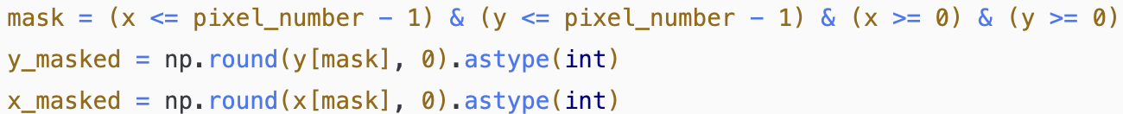
Simulation Process – Main process code
Now that we have calculated our x and y positions of the scattering, we “convert” them to pixel positions by:
Next, we perform the following steps:
1. We mask out all scattering events which occurred outside of the detector.
2. We account for the possibility of multiple scattering events within the same pixel by counting the unique pairs of x,y positions.
3. Finally, we update the appropriate pixel positions on the intensity profile with their scattering counts.
The main process code now ends with returning the updated intensity
add examples + block diagram for next slide

Slide 15
Main code
We will now look at how the main code which executes the simulation is organized, starting with its inputs:
1. wavelength: the wavelength of the scattering in cm
2. slit1_radius, slit2_radius: Half length of slits 1,2 respectively in cm.
3. sample_detector_distance: The distance between the sample and the detector in cm.
4. slit_distance : The distance between the slits in centimeters.
5. detector_length: The length of the detector in cm.
6. detector_center: [x,y] positions array of the detector center in cm.
7. pixel_number: The number of pixels across the axes (total detector size = pixel_number x pixel_number).
8. photon_number: The number of photons (scattering events) of the simulation.
9. LUT_resolution: Initial resolution of the form factor look-up table, used to calculate the scattering probability function before its interpolation (see above slides). The number can be kept relatively low at 10^4, however higher numbers may be useful in more complex form factors.
10. sampling_size: The amount of scattering events to be simulated at once.
11. scattering_function: The scattering function (form factor) to be simulated. Note that the form factor should only be a function of q and Rg. Other parameters may be inserted by casting the form factor into another function (more on this example later on).
12. Rg_average: Average Rg of the scattered particles to be simulated, units of centimeters.
13. Rg_variance: Relative variance of the simulated Rgs, unitless.
14. q_max: maximum q to be accounted for in the simulation. Useful for cases where different sample-detector lengths are compared.

Slide 16
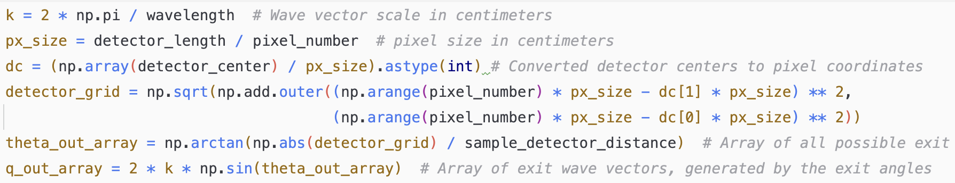
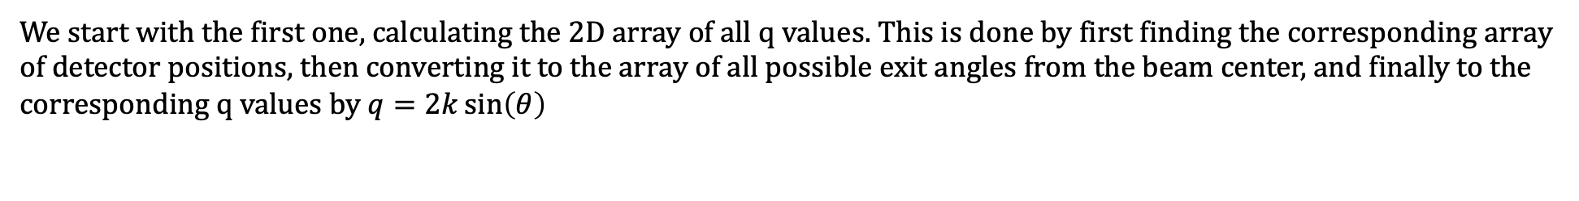
Main code
Given its inputs, the main code performs the following functions.
Calculate the 2D array of all possible q values on the detector
Calculate the scattering probability function and its inverse cumulative distribution
Execute the simulation code as described in the simulation process section.
We start with the first one, calculating the 2D array of all q values. This is done by first finding the corresponding array of detector positions, then converting it to the array of all possible exit angles from the beam center, and finally to the corresponding q values by $q=2k\sin\left(θ\right)$

Slide 17
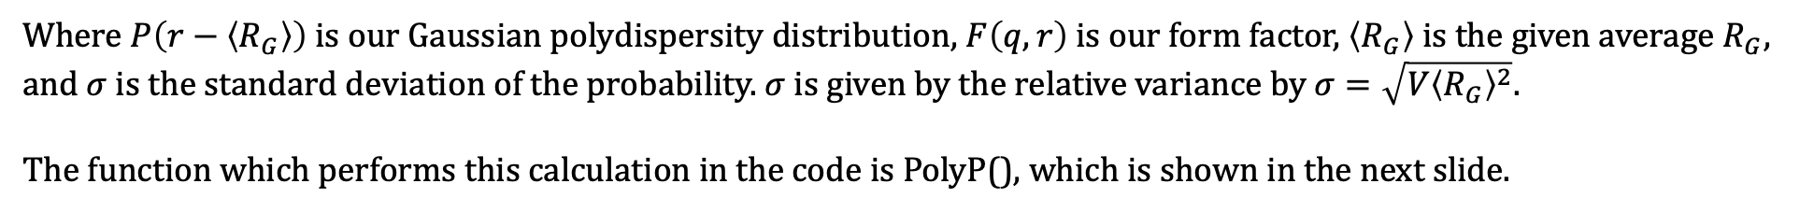
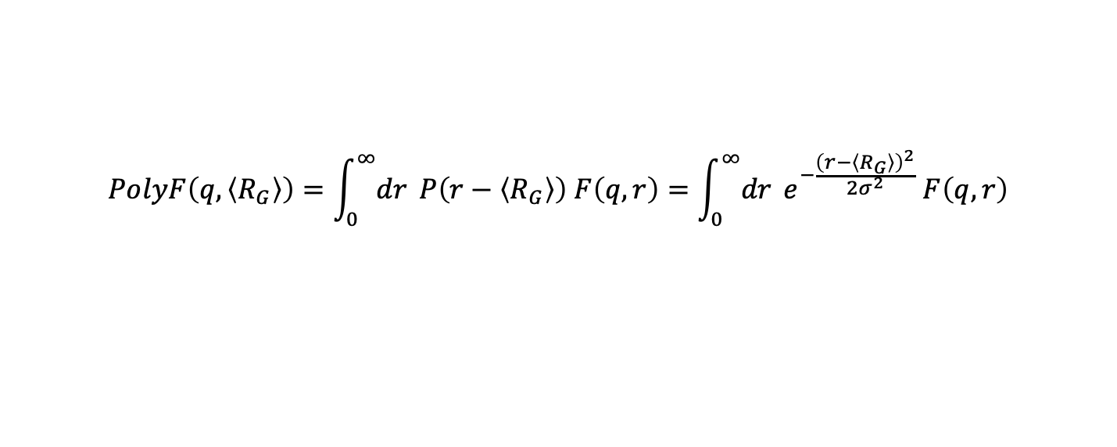
Main code
Next, we aim to find the scattering probability function. To that end, we first calculate the polydisperse form factor given our Rg and variance.
The code assumes that the scattering is Gaussian in nature, however the polydispersity can be substituted into any normalized probability function.
The polydisperse form factor is calculated by:
$$PolyF\left(q,\left\langle R_{G}\right\rangle \right)=\int_{0}^{∞}{dr }P\left(r−\left\langle R_{G}\right\rangle \right) F\left(q,r\right)=\int_{0}^{∞}{dr }e^{−\frac{{\left(r−\left\langle R_{G}\right\rangle \right)}^{2}}{2σ^{2}}} F\left(q,r\right)$$
Where $P\left(r−\left\langle R_{G}\right\rangle \right)$ is our Gaussian polydispersity distribution, $F\left(q,r\right)$ is our form factor, $\left\langle R_{G}\right\rangle$ is the given average $R_{G}$, and $σ$ is the standard deviation of the probability. $σ$ is given by the relative variance by $σ=\sqrt{V{\left\langle R_{G}\right\rangle }^{2}}$.
The function which performs this calculation in the code is PolyP(), which is shown in the next slide.

Slide 18
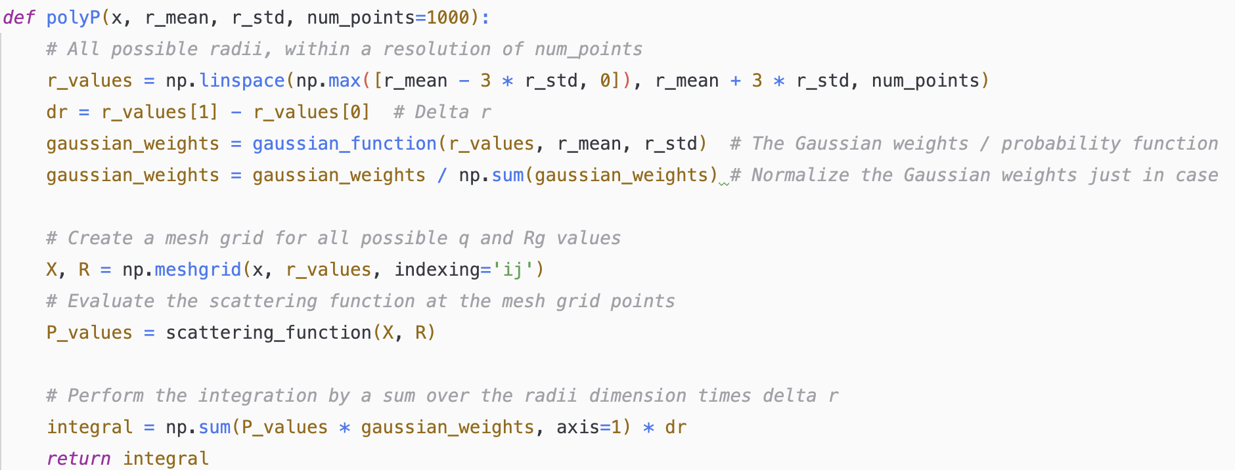
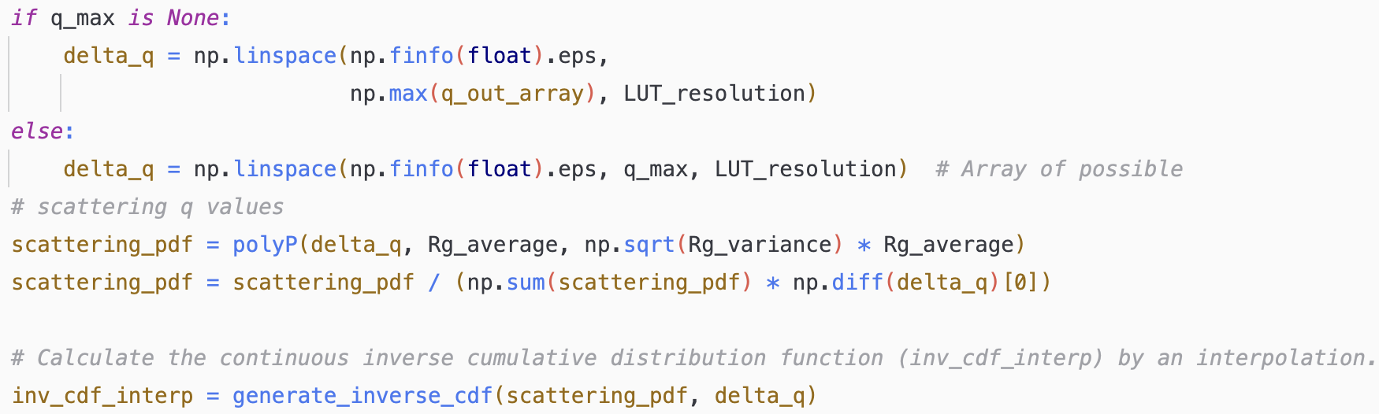
Main code
From here, we normalize the scattering function and calculate its inverse cumulative distribution as explained in the previous slides.

Slide 19
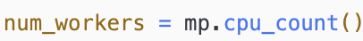
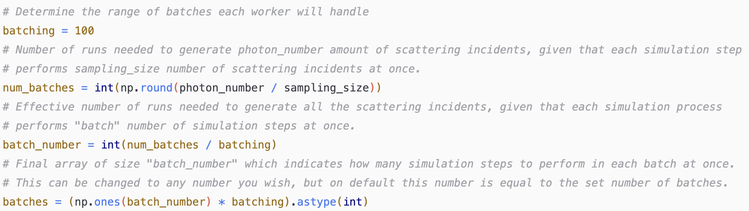
Main code
The next step is to initialize the simulation itself. To alleviate long run times, the simulation process is done in multiprocessing, where each CPU thread oversees executing a set number of scattering simulations (batches).
This is done using the “multiprocessing” library of Python, in combination with the “tqdm” library which will be responsible to print the real-time progress of the simulation as it is running.
We first check the number of workers (CPU threads) available for the computer by:
We then set the batching as follows: The workers divide between themselves photon number / sampling number amounts of simulations to perform, as In each simulation, sampling number of scattering incidents are being preformed simultaneously. To make this process even faster, we assign an additional batching number “batch” which will indicate how many such simulation steps to perform in each execution of the simulation run. Hence, the effective number of batches will be:

Slide 20
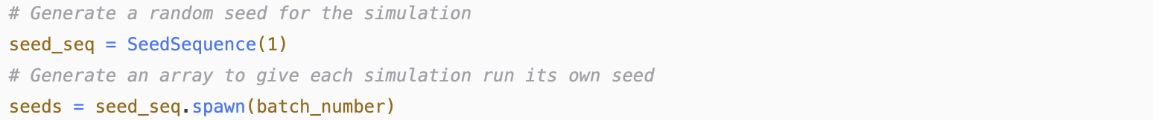
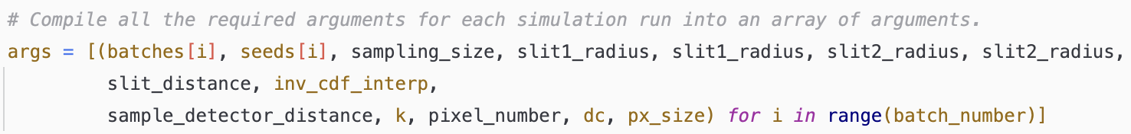
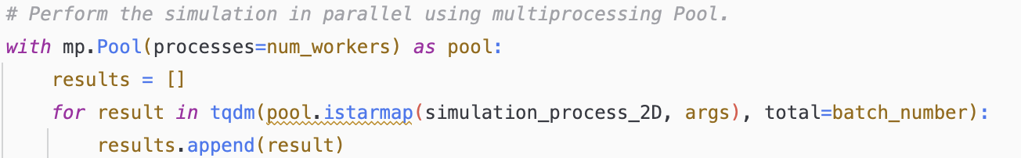
Main code
Finally, we arrive to the last step which is to compile all the variables which we have prepared and send them to the simulation.
We first start by generating a random randomization seed for each simulation run.
We then compile all the relevant simulation arguments into a size “batch_number” tuple “args”, which contains all the arguments per simulation run.
We finally start the multiprocessing process of the simulation, using a modified version of the “starmap” function of “multiprocessing.pool” which allows us to enter multiple arguments into the process while simultaneously using “tdqm” to track its progress. This modified version is referred to as “istarmap” and its code is provided together with the simulation code.

Slide 21
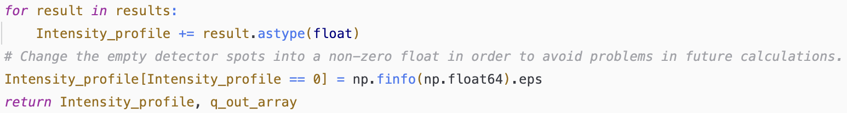
Main code
Lastly, we compile all the simulation results into our intensity profile array and replace any zeroes with the smallest float number to avoid calculation errors further on in the analysis.
add slides for flattening the data and how we normalize it

